Slide 1
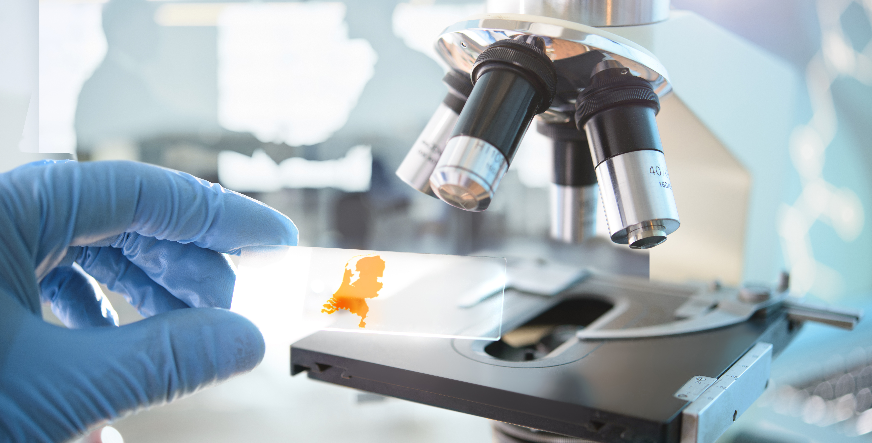

Plaatsnaam |
Notes:
All slides within this slidedeck contain information that comes from our bidbook.
Publication: https://www.health-holland.com/rxlr/#p=1

Slide 2
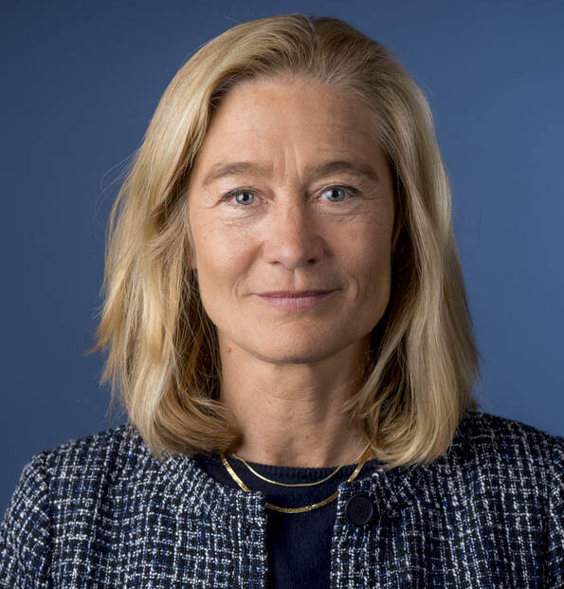
The Life Sciences & Health sector in the Netherlands is flourishing
“
I am proud that our dynamic international ecosystem brings together innovative companies and researchers from around the world to make a vital impact in the field. Now, more than ever, I believe we are truly well positioned to develop advancements for the future of global health.
“
Micky Adriaansens,
Minister of Economic Affairs and Climate Policy
Notes:
Foreword page 6

Slide 3
Notes:
See bidbook page 17

Slide 4
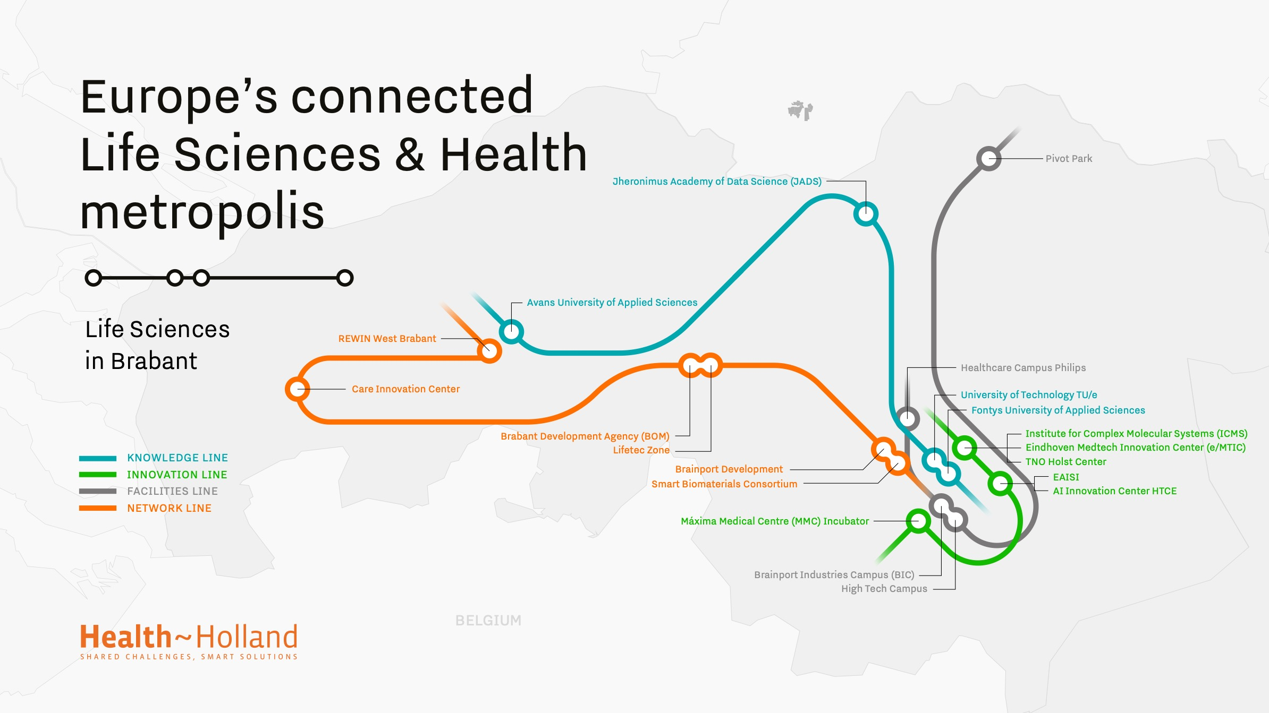
Notes:
Regional Tubmaps

Slide 5
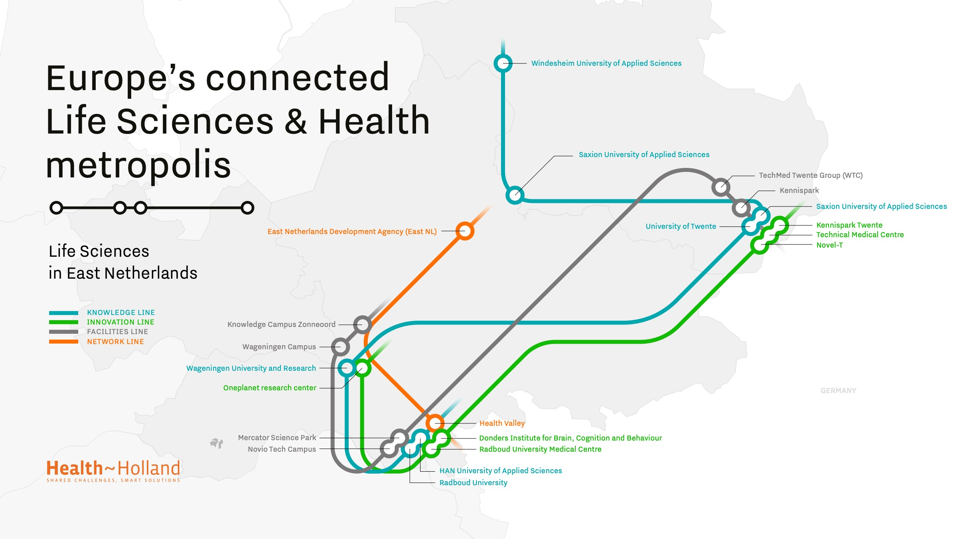

Slide 6
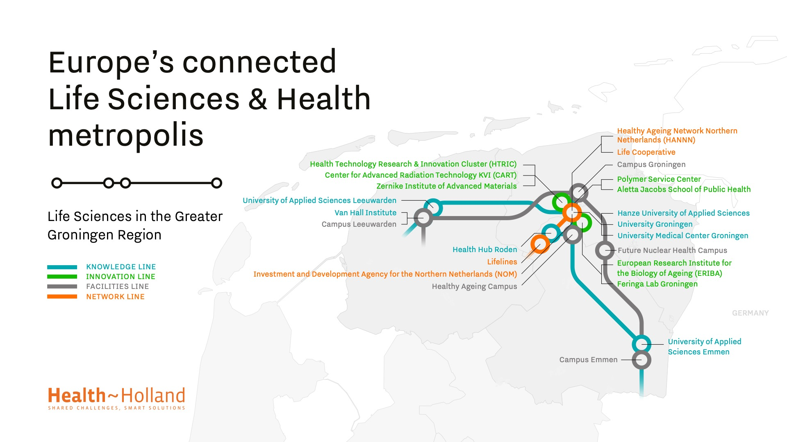

Slide 7
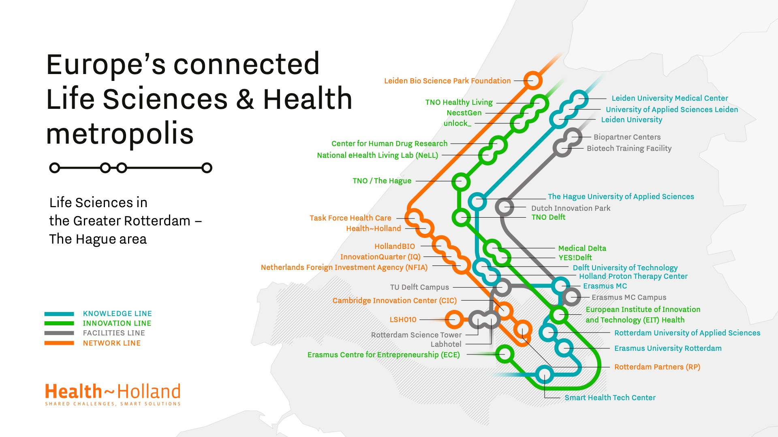

Slide 8
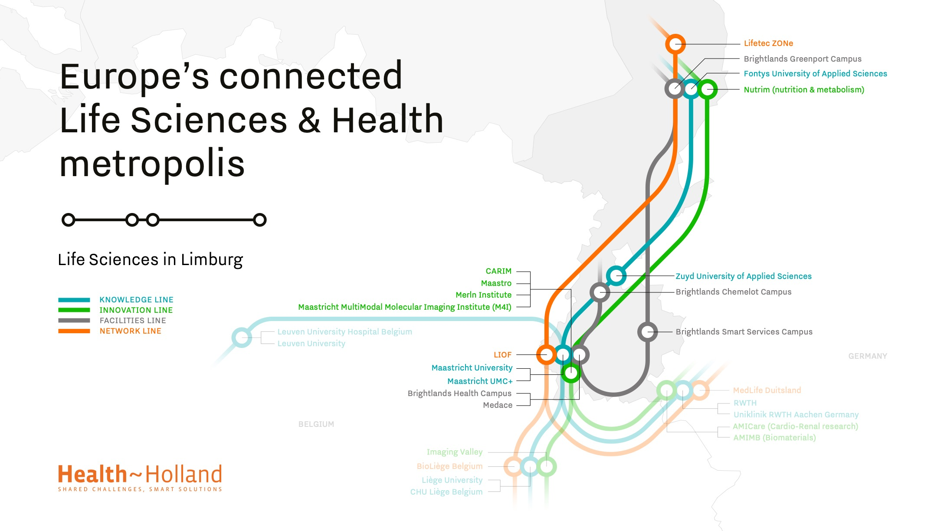

Slide 9
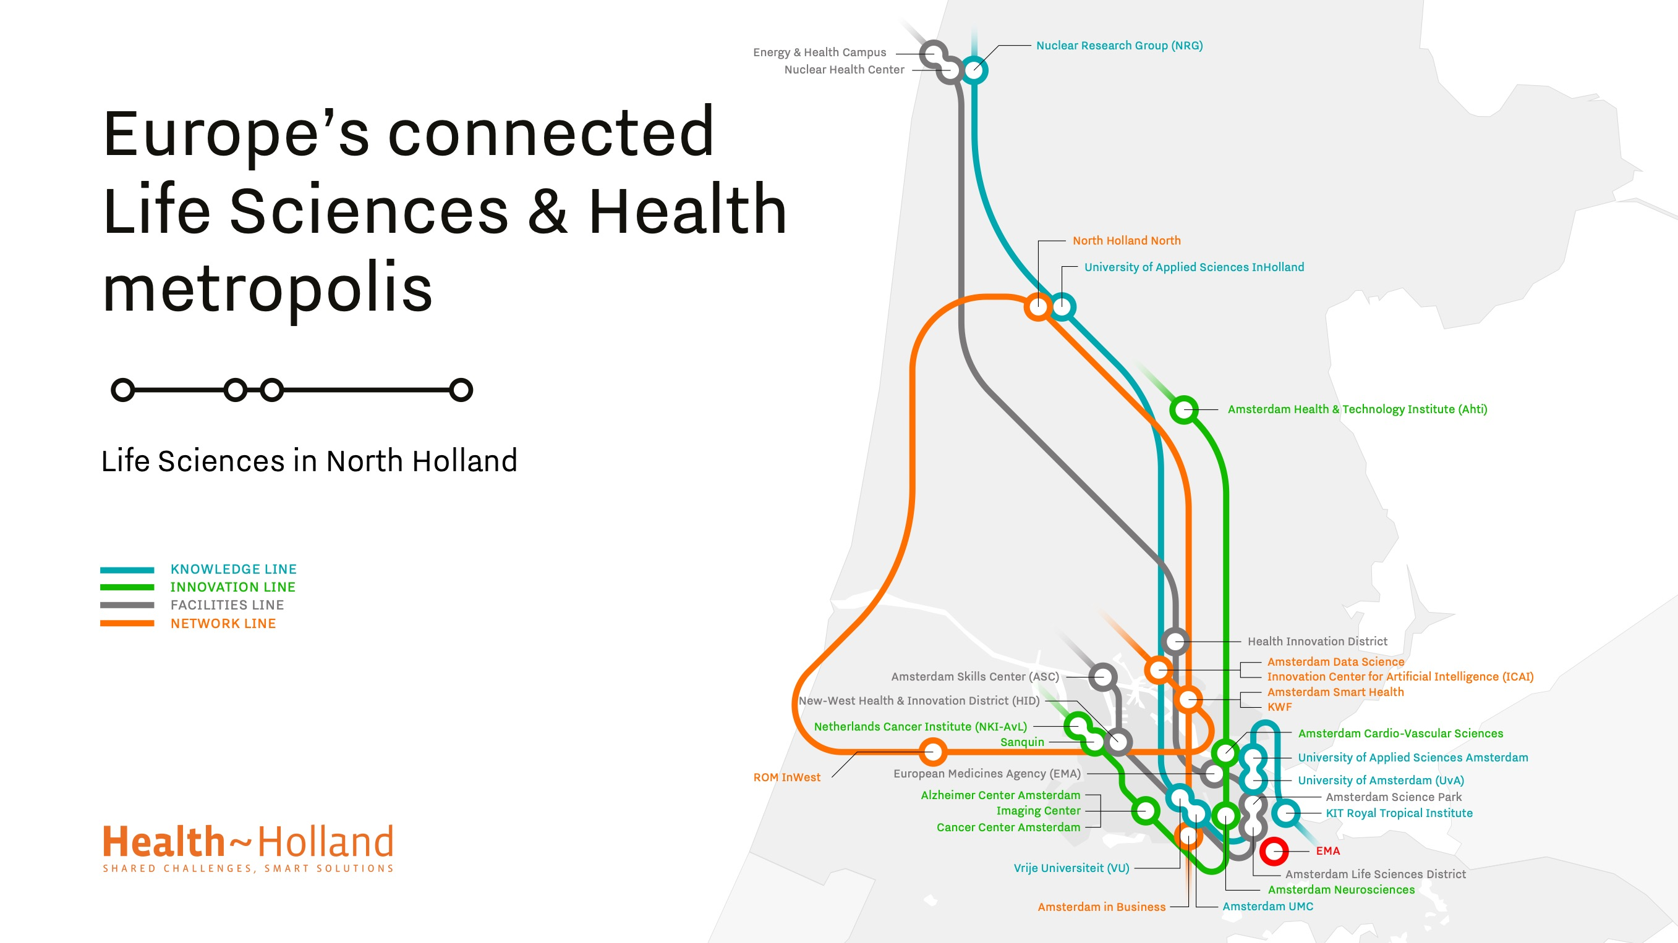

Slide 10
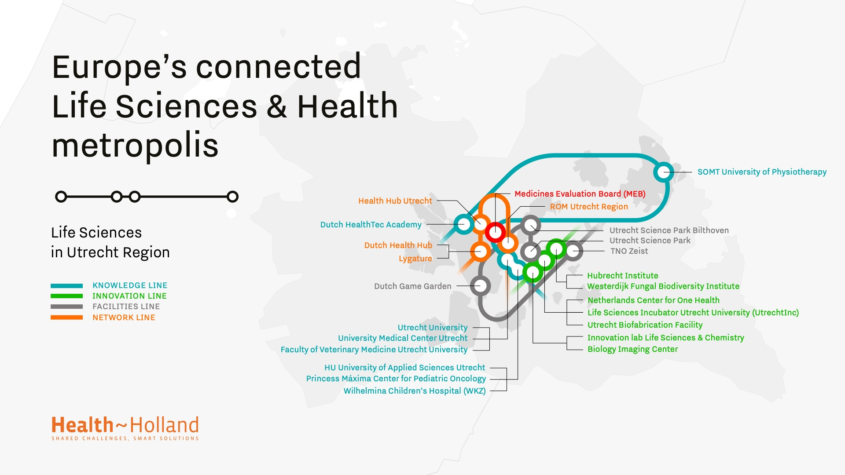

Slide 11
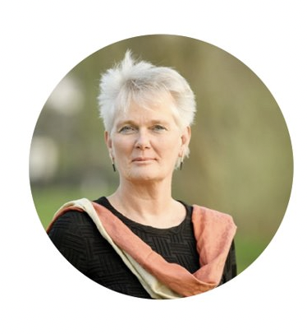
“
We are located at the heart of Europe and globally connected via excellent digital and physical infrastructure. What makes us unique, are the quadruple helix collaborations in which citizens, researchers, government and entrepreneurs are working together to drive innovation in healthcare
“
Carmen van Vilsteren
Chair Top Sector Life Sciences & Health (Health~Holland)
Notes:
See page 16

Slide 12
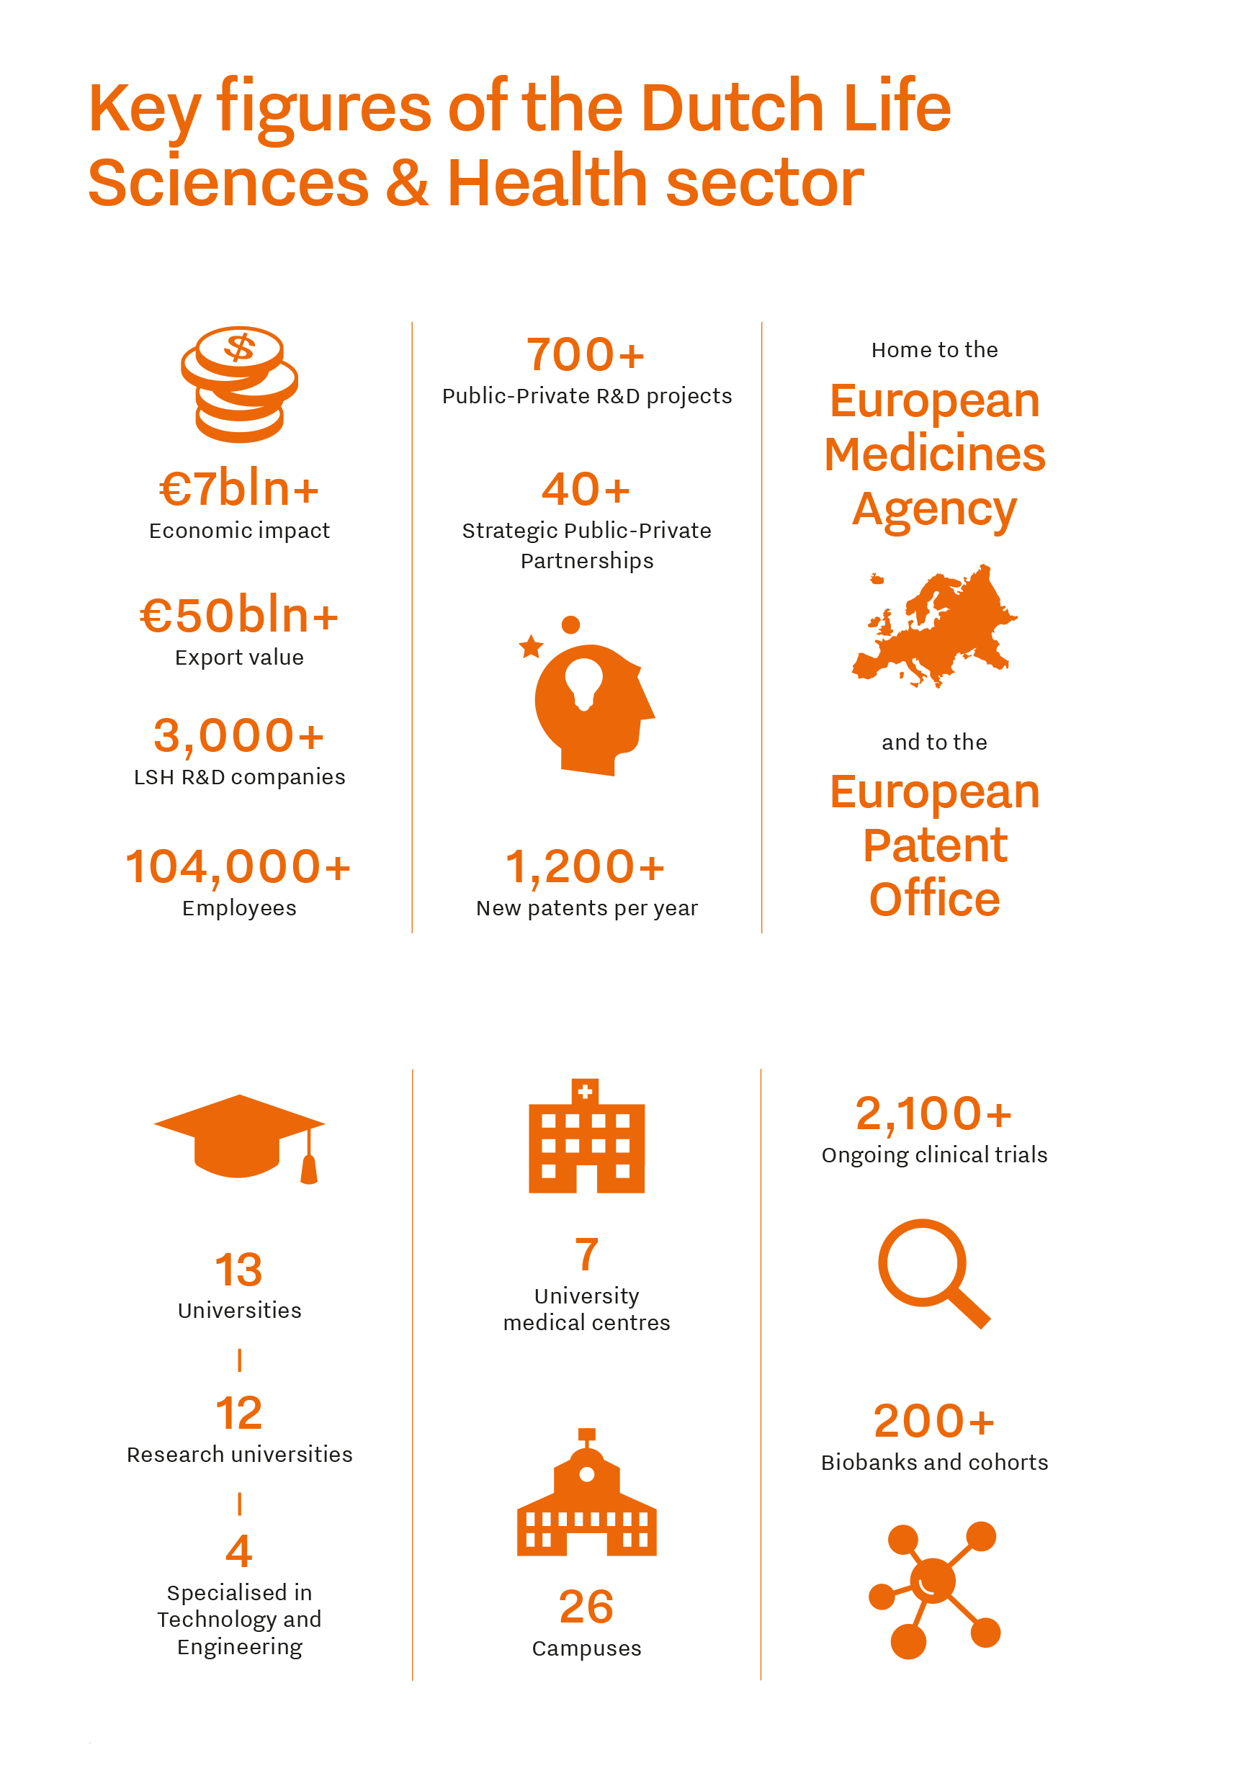
Plaatsnaam |
Key figures of the Dutch Life Sciences & Health sector
Notes:
See page 10

Slide 13
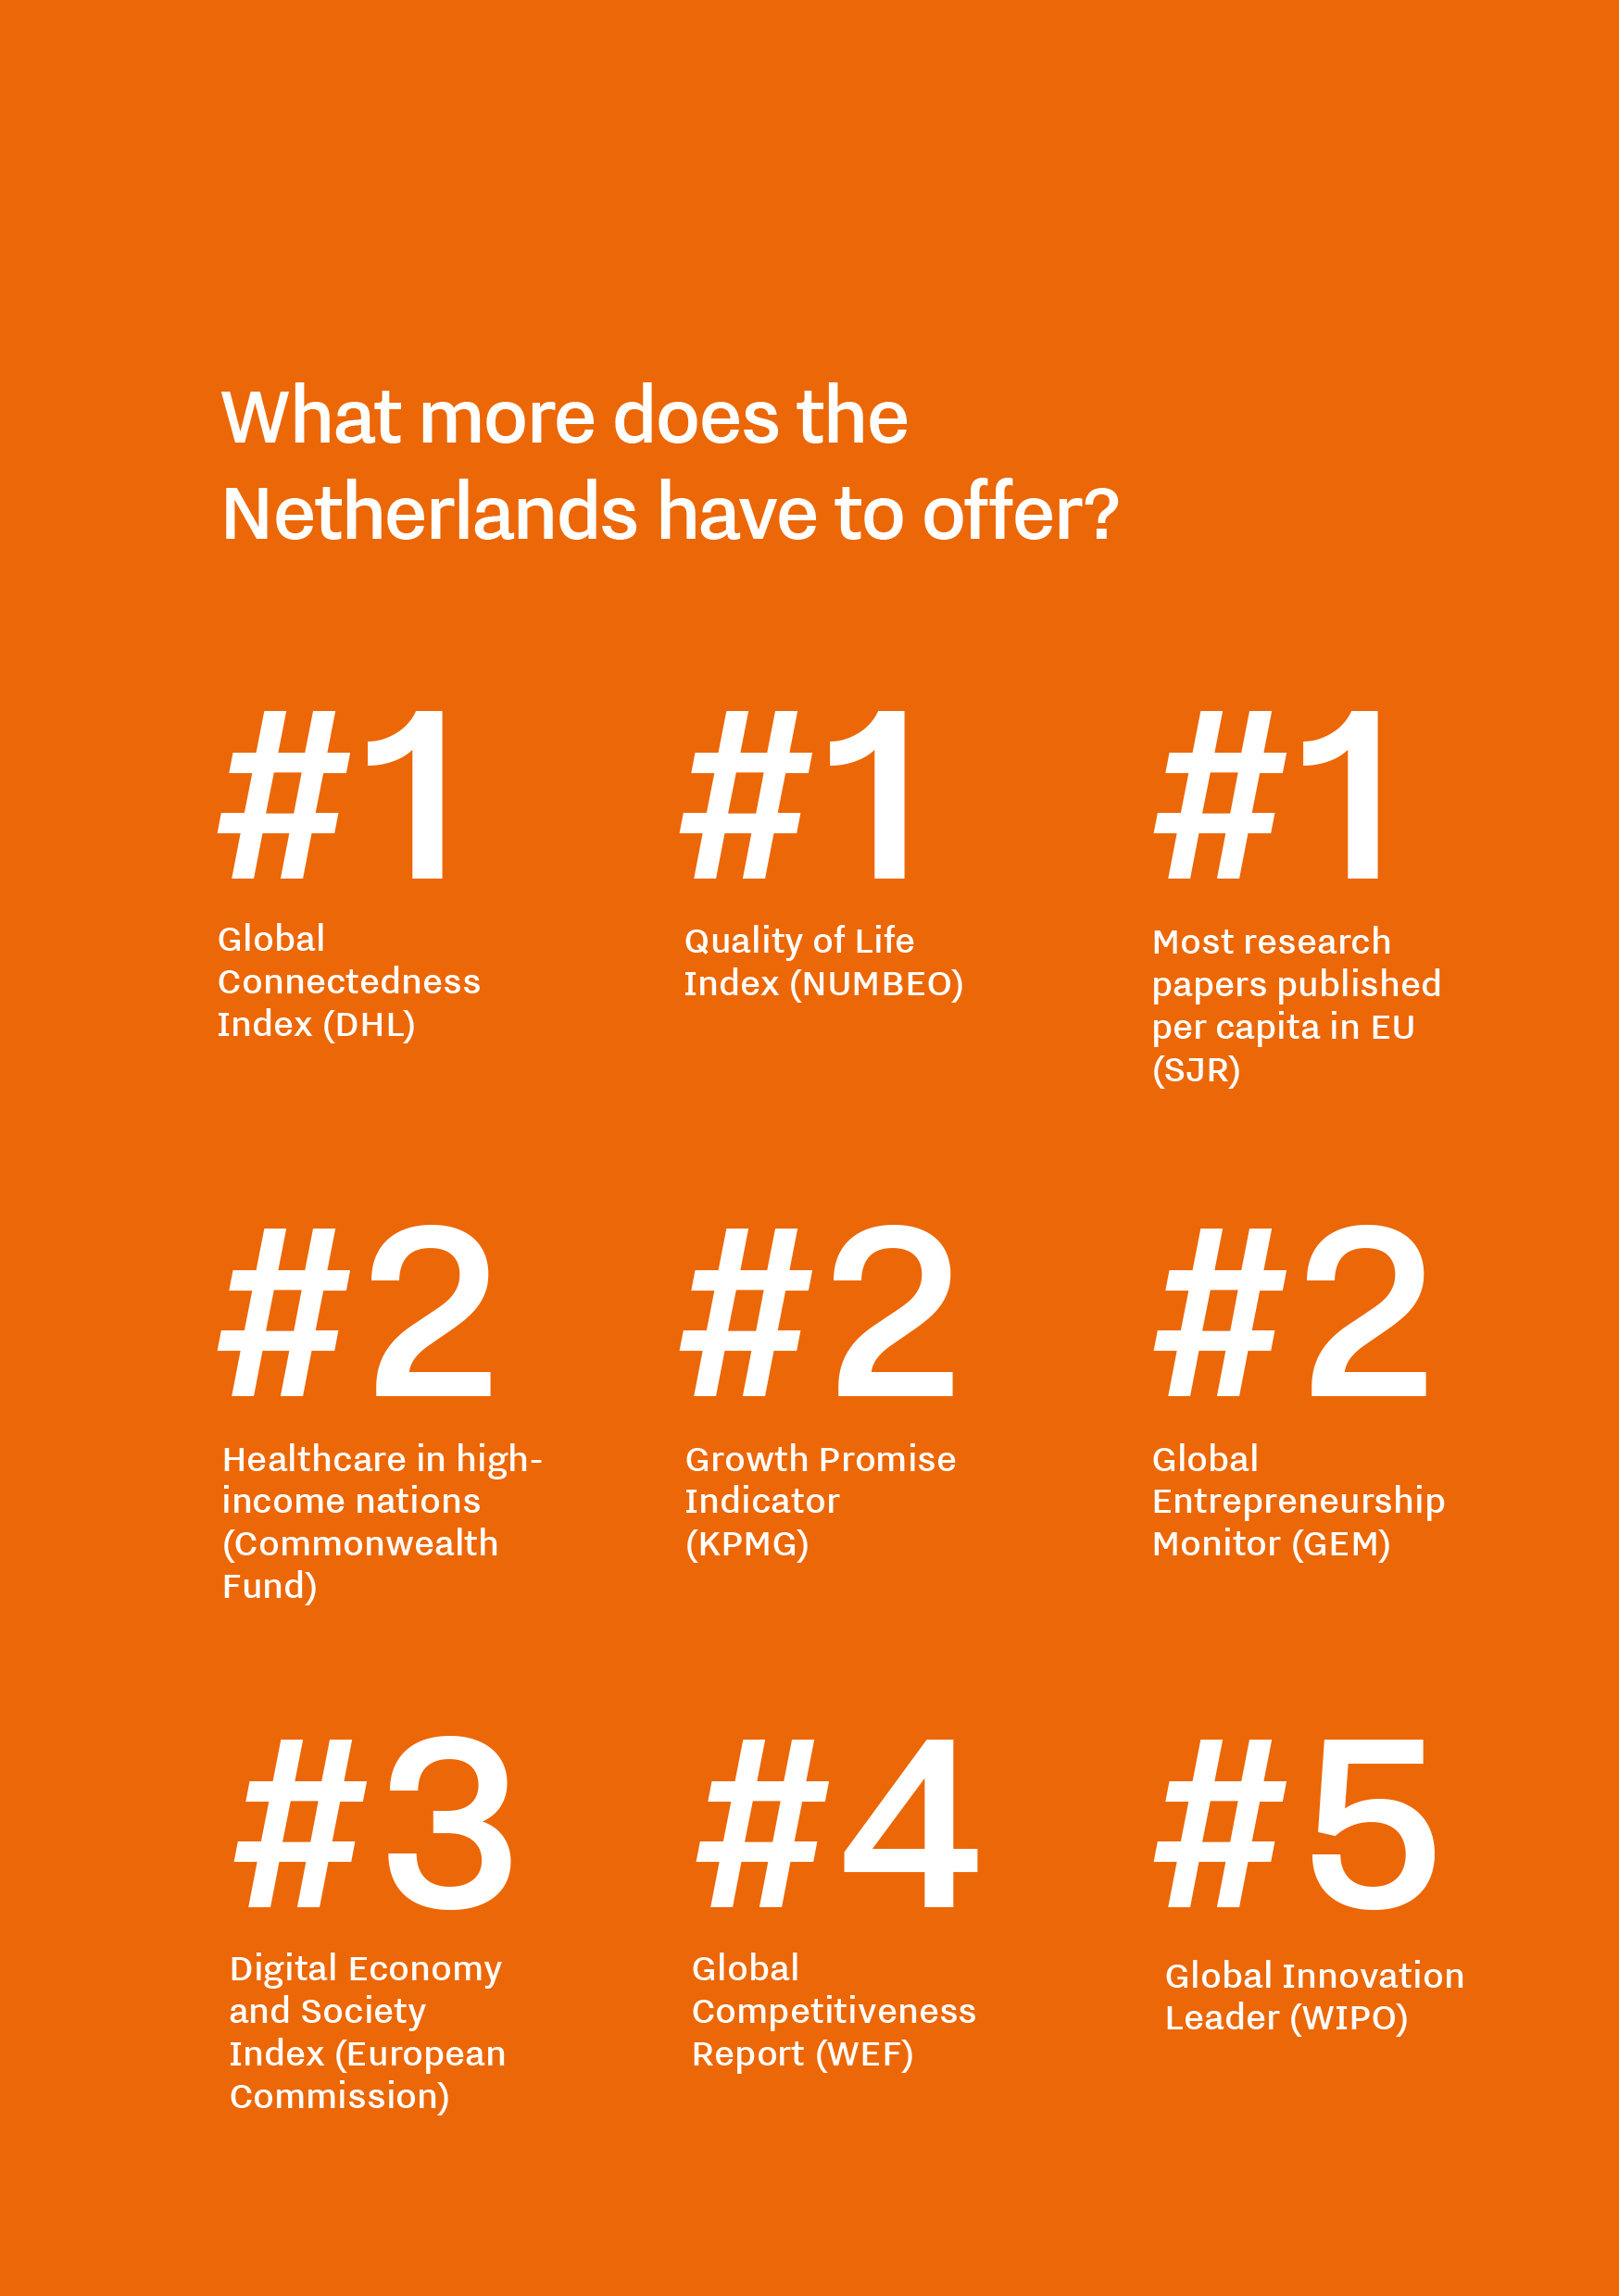
Plaatsnaam |
What does the Netherlands have to offer?
Notes:
See page 11

Slide 14

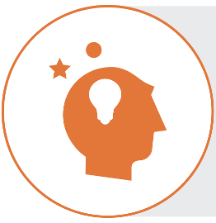
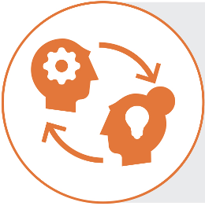
Three reasons why you should join our vibrant Life Sciences & Health ecosystem
A well-connected
hub
The Netherlands offers a prime geographical location at the heart of Europe
With seamless collaboration
We are proud to offer an ecosystem of Public-Private Parties
Creating drivers of innovation
As a small but highly versatile country, we have an ongoing commitment to innovate
Notes:
See page 14

Slide 15
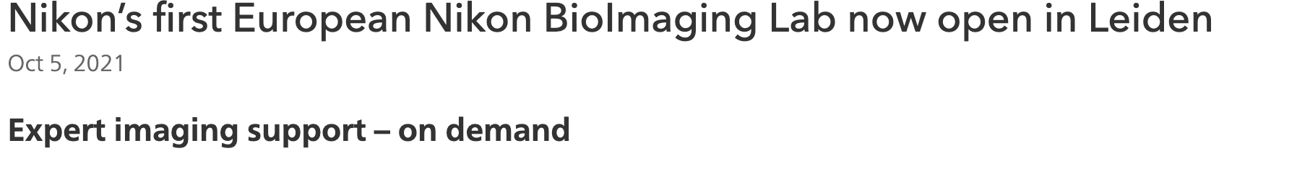
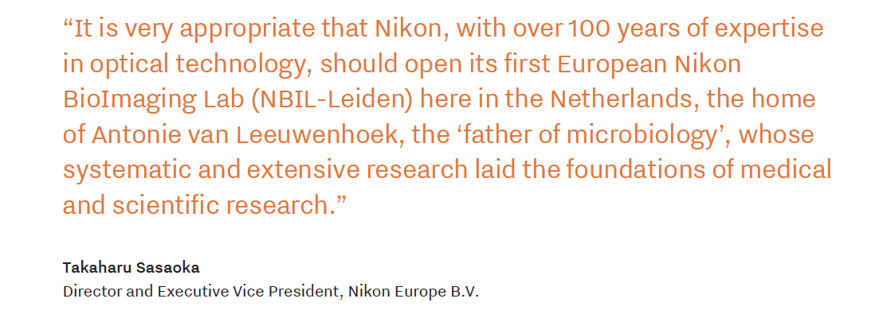
Plaatsnaam |
Tradition of Innovation
The Netherlands is one of the most innovative countries in the world thanks to its propensity for collaborative ventures and its forward-thinking culture that is traditionally open to experimentation and new ideas.
As a result of this, the Dutch have made numerous contributions to the world of medicine, including:
the microscope
the first European blood bank
the artificial heart
the artificial kidney
electrocardiograms
and organoids
Notes:
A Mission-driven Top Sectors & Innovation Policy helps guide the process of innovation by providing direction for social, scientific, and business innovation processes.
See page 19

Slide 16
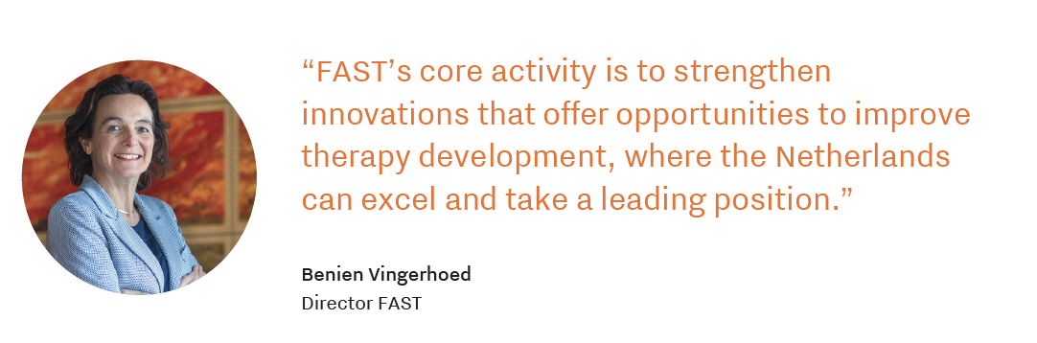
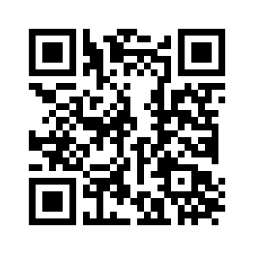
Therapy development
Centre for Future Affordable Sustainable Therapy Development (FAST)
FAST is initiated to foster faster, smarter, and more sustainable development, production and access of new therapies for patients, commissioned by the Dutch government.
About FAST
Notes:
More about FAST on page 20.

Slide 17
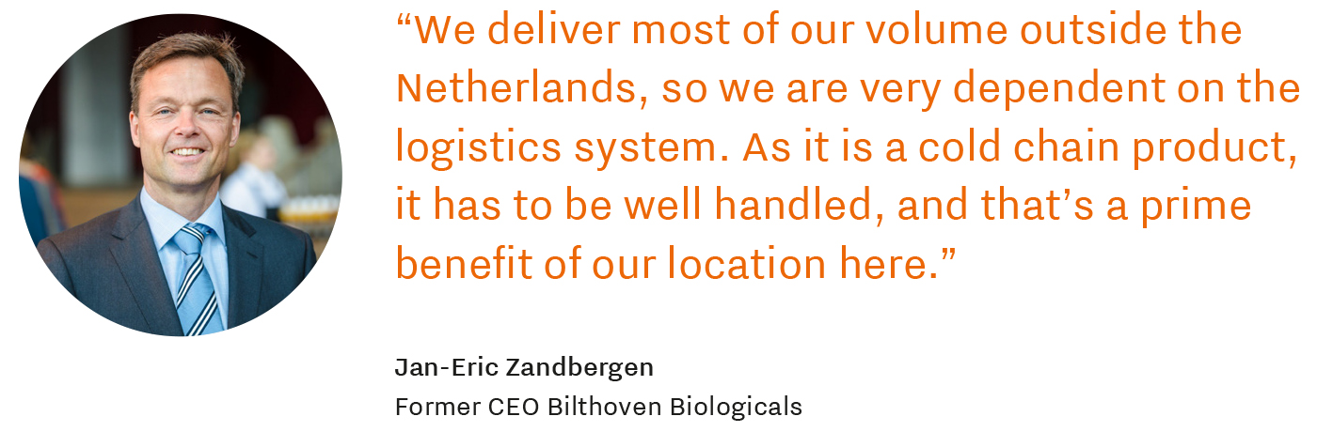
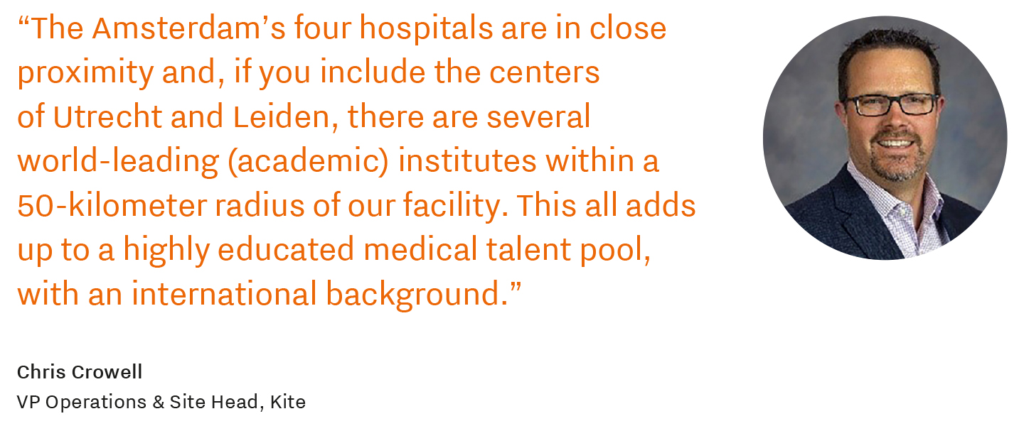
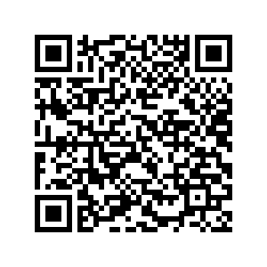
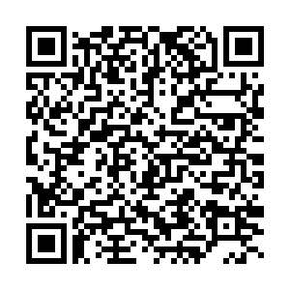
Plaatsnaam |
Succes Stories
How the Netherlands became a key player for vaccine development
How the Netherlands Allows Cell and Gene Therapy Businesses to Scale-up
Full story
Full story
Notes:
See bidbook page 22 – 23

Slide 18
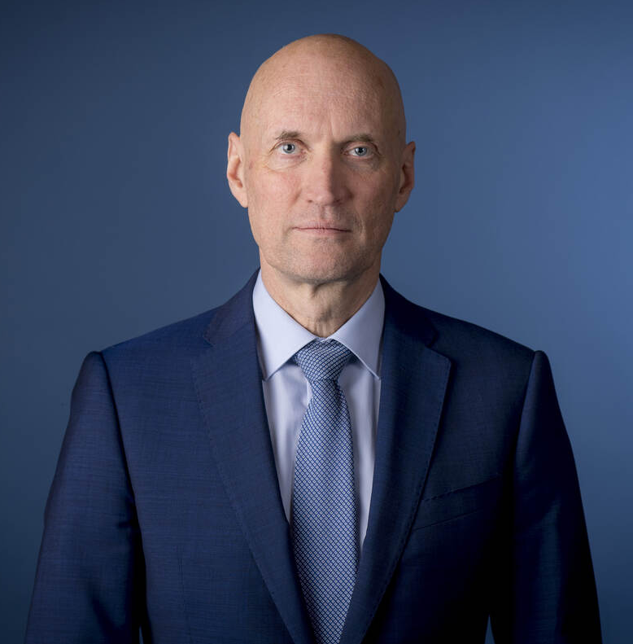
Innovation is vital to address today’s foremost societal challenges
“
In the coming years, our government will continue to encourage and support public-private partnerships. The ‘quadruple helix’ approach in the Life Sciences & Health sector is founded on intensive collaboration among knowledge institutes, government, the private sector and the patient.
“
Ernst Kuipers
Minister of Health, Welfare and Sport
Notes:
Foreword page 8

Slide 19
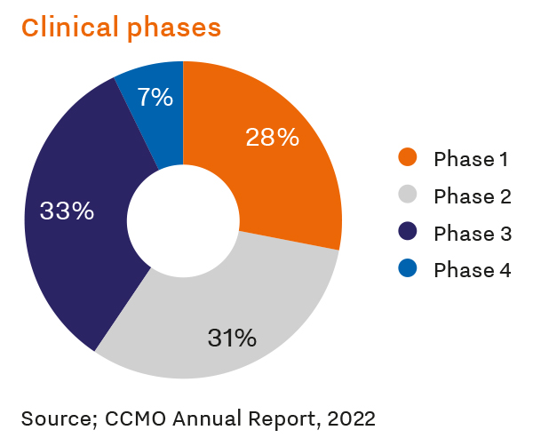
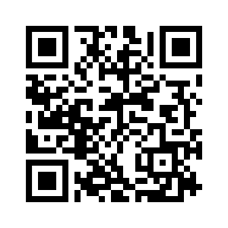
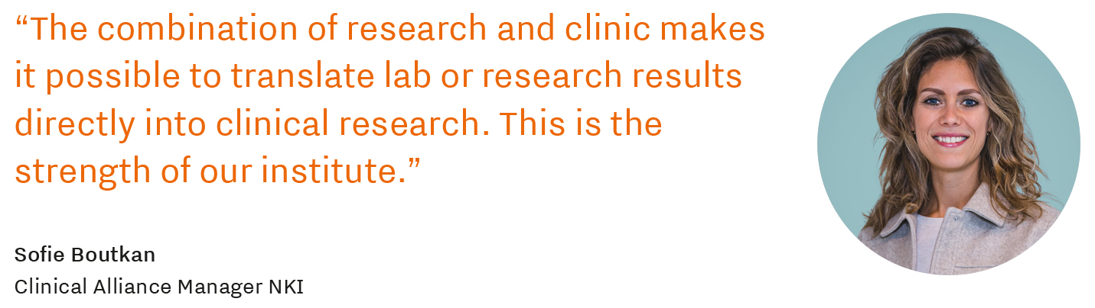
Clinical research
Clinical drug trials
The Netherlands is renowned for its expertise in early-stage clinical research but performs equally well in other clinical phases. Around 600 new clinical drug trial are initiated annually, with approximately 60,000 participants.
About NKI
Notes:
See page 26 of the bidbook.
NKI: Nederlands Kanker Insituut (Netherlands Cancer Institute)

Slide 20
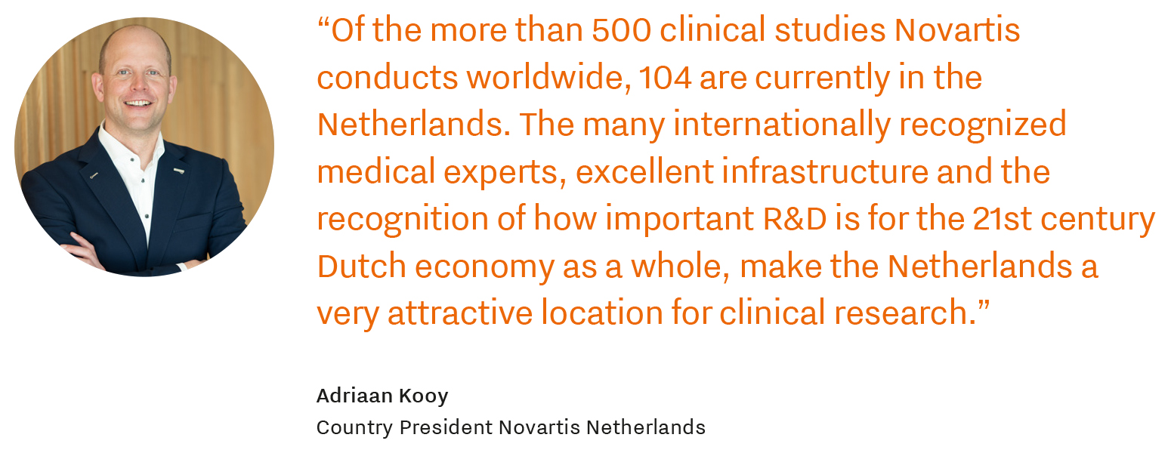
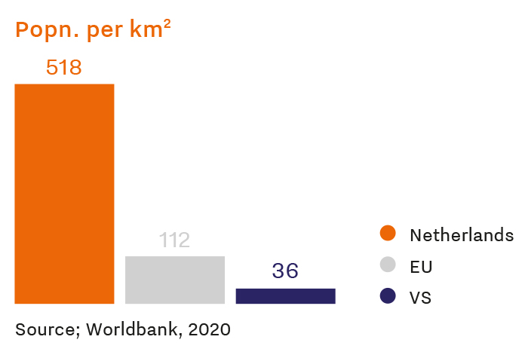
Close to patients
Notes:
The Netherlands is one of the most densely populated countries in the world. As a result, more than six in ten people in the Netherlands live within 5 km of a hospital. More than 200 active biobanks, cohort studies, and patient registers can be accessed to.
See page 28 of the bidbook
Popn: Population

Slide 21
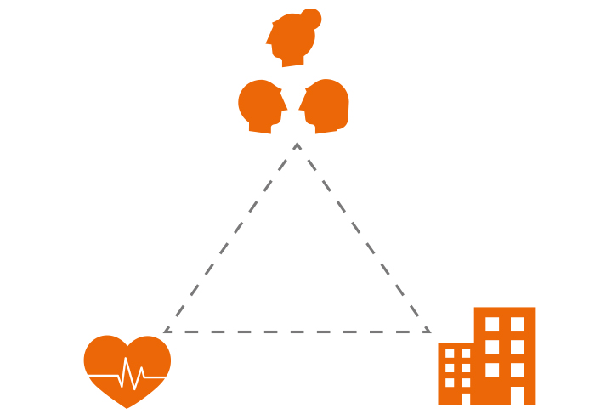
Dutch Healthcare system
Private individual/Insured person
One of the most attractive aspects of living in the Netherlands is its first-rate healthcare.
The philosophy underpinning the Dutch healthcare system is based on several universal principles: access to care for all, solidarity through medical insurance (which is compulsory for all and available to all), and high-quality healthcare services.
Healthcare providers
Health insurer
Notes:
One of the most attractive aspects of living in the Netherlands is its first-rate healthcare. The Netherlands ranks 2nd in the Health Care and has ranked consistently among the top three published by the Health Consumer System Performance Rankings, based on 11 high income countries (Common Wealth Fund).
See page 54 of the bidbook

Slide 22
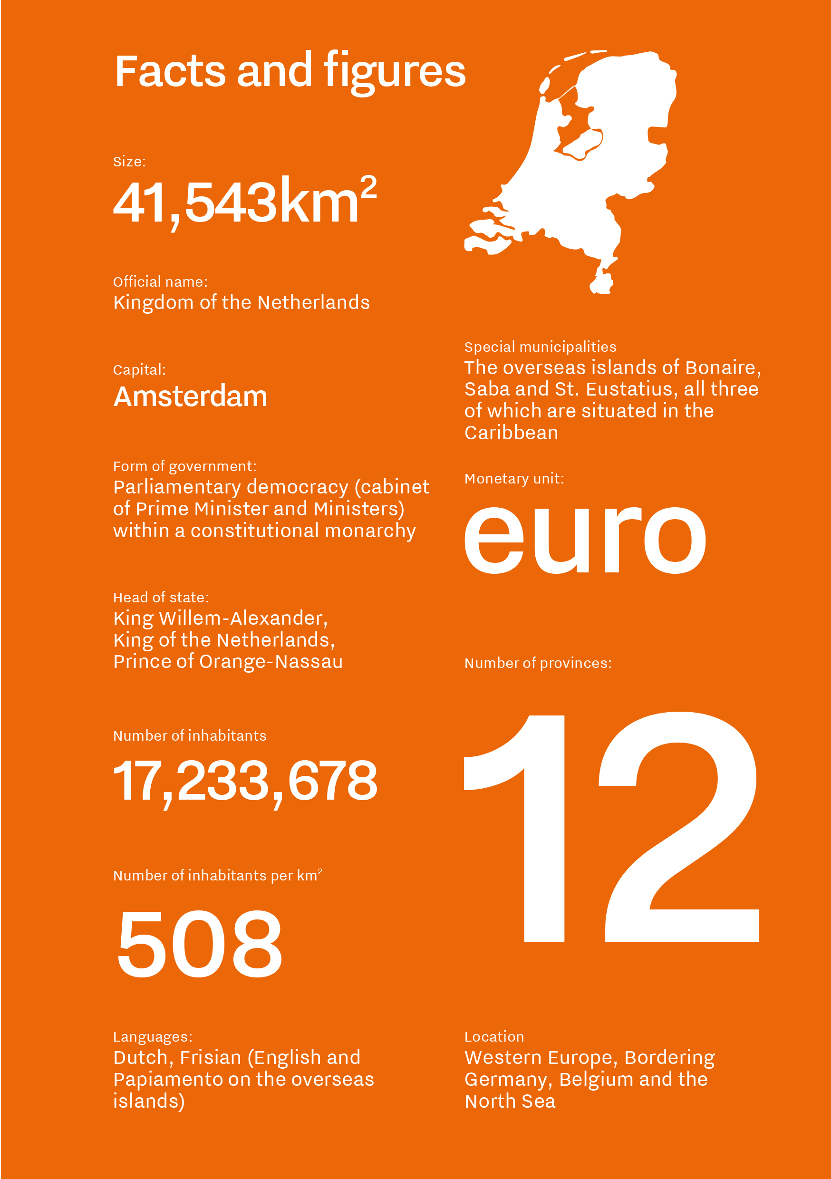
Notes:
See page 55 of the bidbook

Slide 23
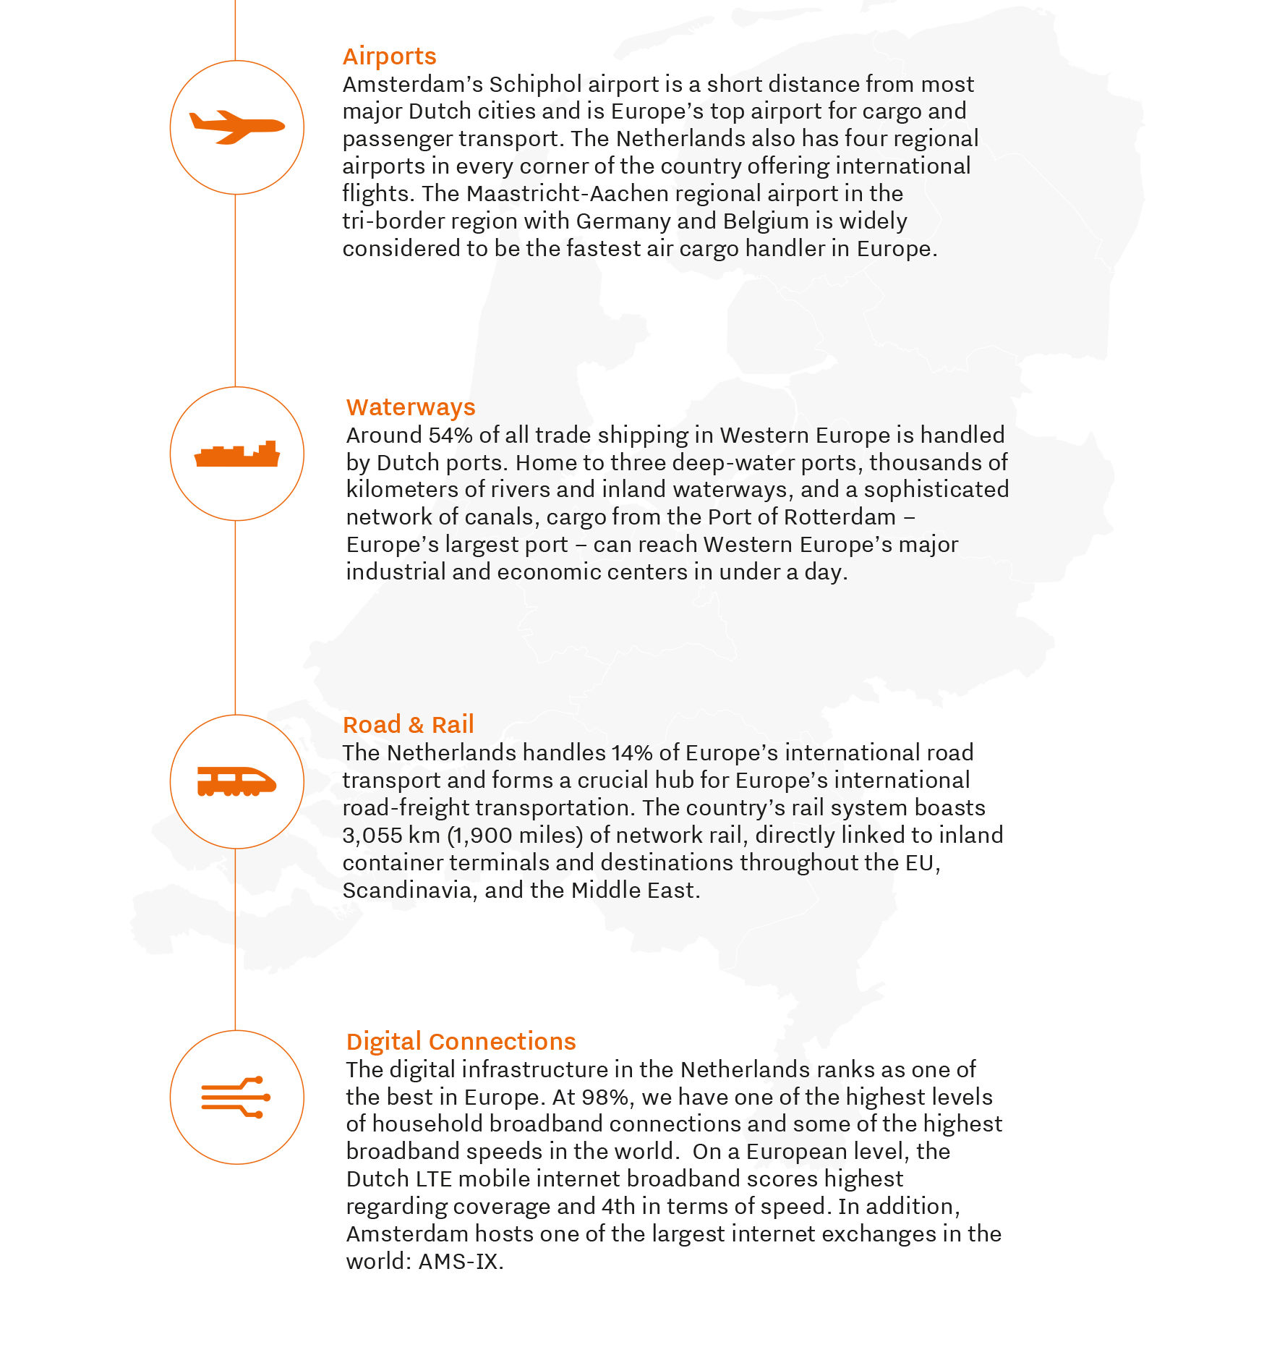
An enabling environment for business and innovation
The Netherlands is the most competitive economy in Europe according to the WEF Competitiveness Index. Our nation has a lot going for it. A great location, well-connected, and a highly educated and skilled workforce, all making the Netherlands an attractive place for innovative business.
Notes:
See page 40 of the bidbook

Slide 24
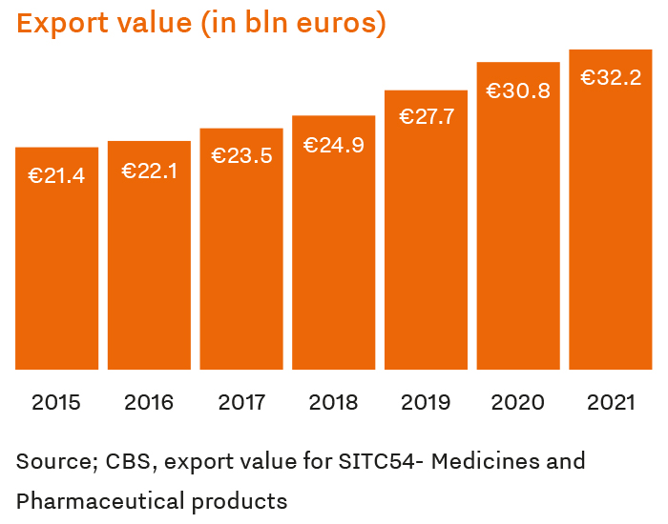
Manufacturing & distribution
The combination of a favorable geographic location, high-quality expertise, and excellent logistics infrastructure makes the Netherlands an attractive strategic base for setting up manufacturing and distribution operations.
The unparalleled connectedness of the Dutch Life Science & Health ecosystem is also mirrored by physical connectivity and logistical services that essential to many LSH businesses. This is borne out by the fact that the Netherlands has topped DHL’s Global Connectedness Index every year since 2005.
Notes:
See page 31 & 32 of the bidbook

Slide 25
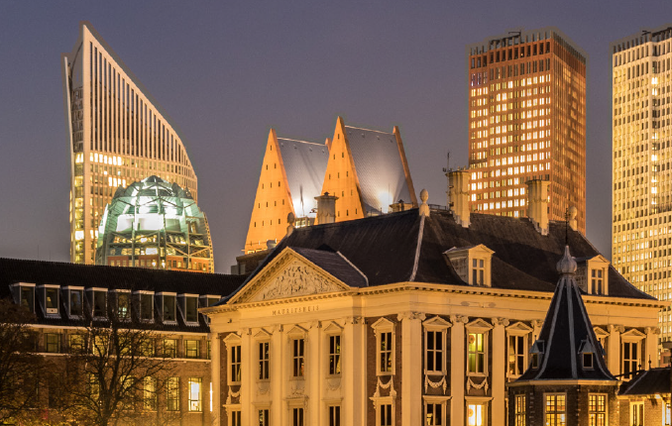
Incentives for innovation and sustainability
A wide network of nearly 100 bilateral tax treaties to avoid double taxation and to provide, in many cases, reduced or no withholding tax on dividends, interest and royalties.
Clarity and certainty in advance on the tax consequences of proposed significant invest in the Netherlands.
A broad participation exemption which is vital for European headquarters
An efficient fiscal unity regime, providing taks consolidation for Dutch activities within a corporate group
No withholding tax on outgoing interest and royalty payments in most cases
A relatively low statutory corporate income tax rate of 25%
For companies looking to bring employees from abroad, the 30% ruling
allows employers to offer 30% of employee salaries taks-free for five years
Notes:
Tax policy in the Netherlands encapsulates among others, the following benefits:
See page 44 of the bidbook
Full:
A wide network of nearly 100 bilateral tax treaties to avoid double taxation and to provide, in many cases, reduced or no withholding tax on dividends, interest and royalties.
Clarity and certainty in advance on the tax consequences of proposed significant invest in the Netherlands.
A broad participation exemption (100% exemption for qualifying dividends and capital gains) which is vital for European headquarters
An efficient fiscal unity regime, providing taks consolidation for Dutch activities within a corporate group
No withholding tax on outgoing interest and royalty payments in most cases
A relatively low statutory corporate income tax rate of 25%
For companies looking to bring employees from abroad, the 30% ruling allows employers to offer 30% of employee salaries taks-free for five years

Slide 26
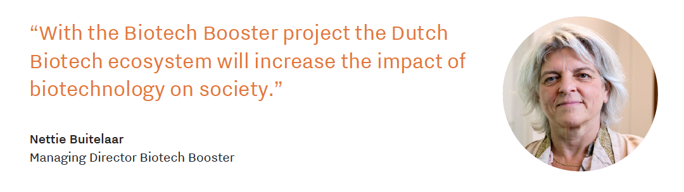
The National Growth Fund
The National Growth Fund has a budget of 20 billion euros to invest in projects that stimulate economic growth in the long term. Innovation projects from the LSH sector have already secured over 500 million euros in funding.
An example of this is the Biotech Booster, which is a national program focusing on accelerating the commercialization of biotechnology findings.
Notes:
Page 45

Slide 27


Talent and education
14 universities
36 universities of applied sciences
25 secondary vocational educational institutes
In 2022 276,713 students in Bachelor or Master programs
Over 52,000 in health programs
Over 81,000 in technology studies
495,00 attending secondary vocational
Notes:
Number of students enrolled at (scientific) universities and vocational institutes has grown rapidly in recent years
Page 42

Slide 28
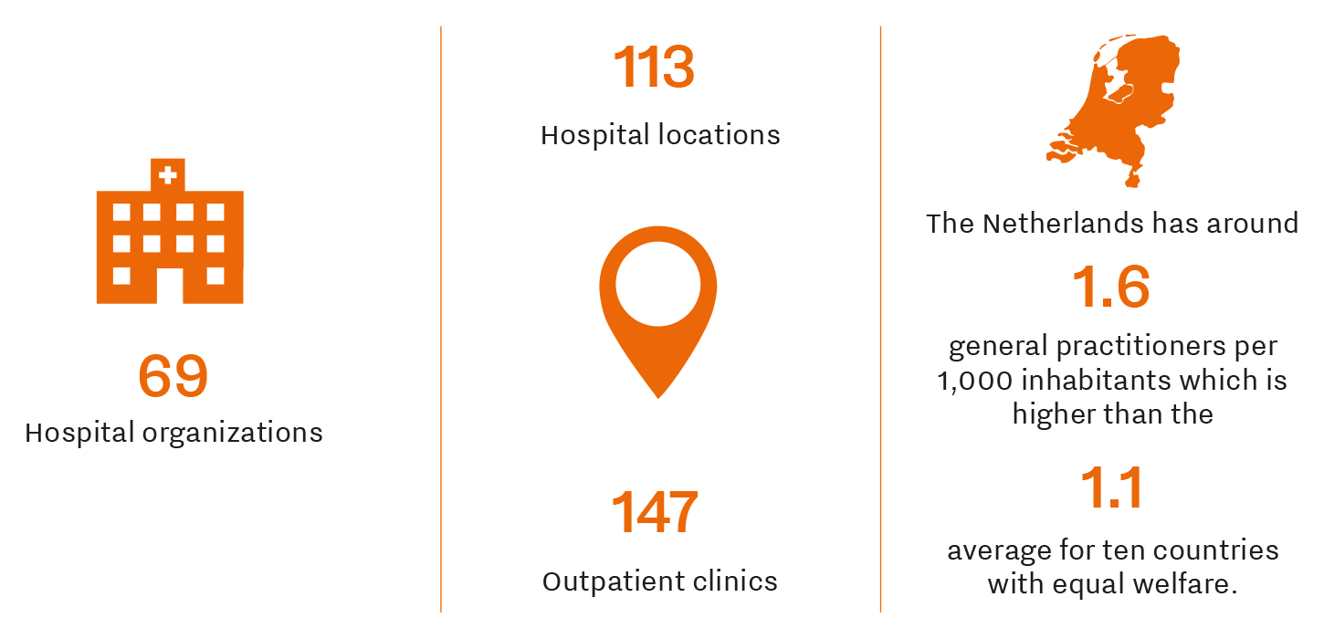
Facts & Figures
Notes:
See page 32 of the bidbook

Slide 29
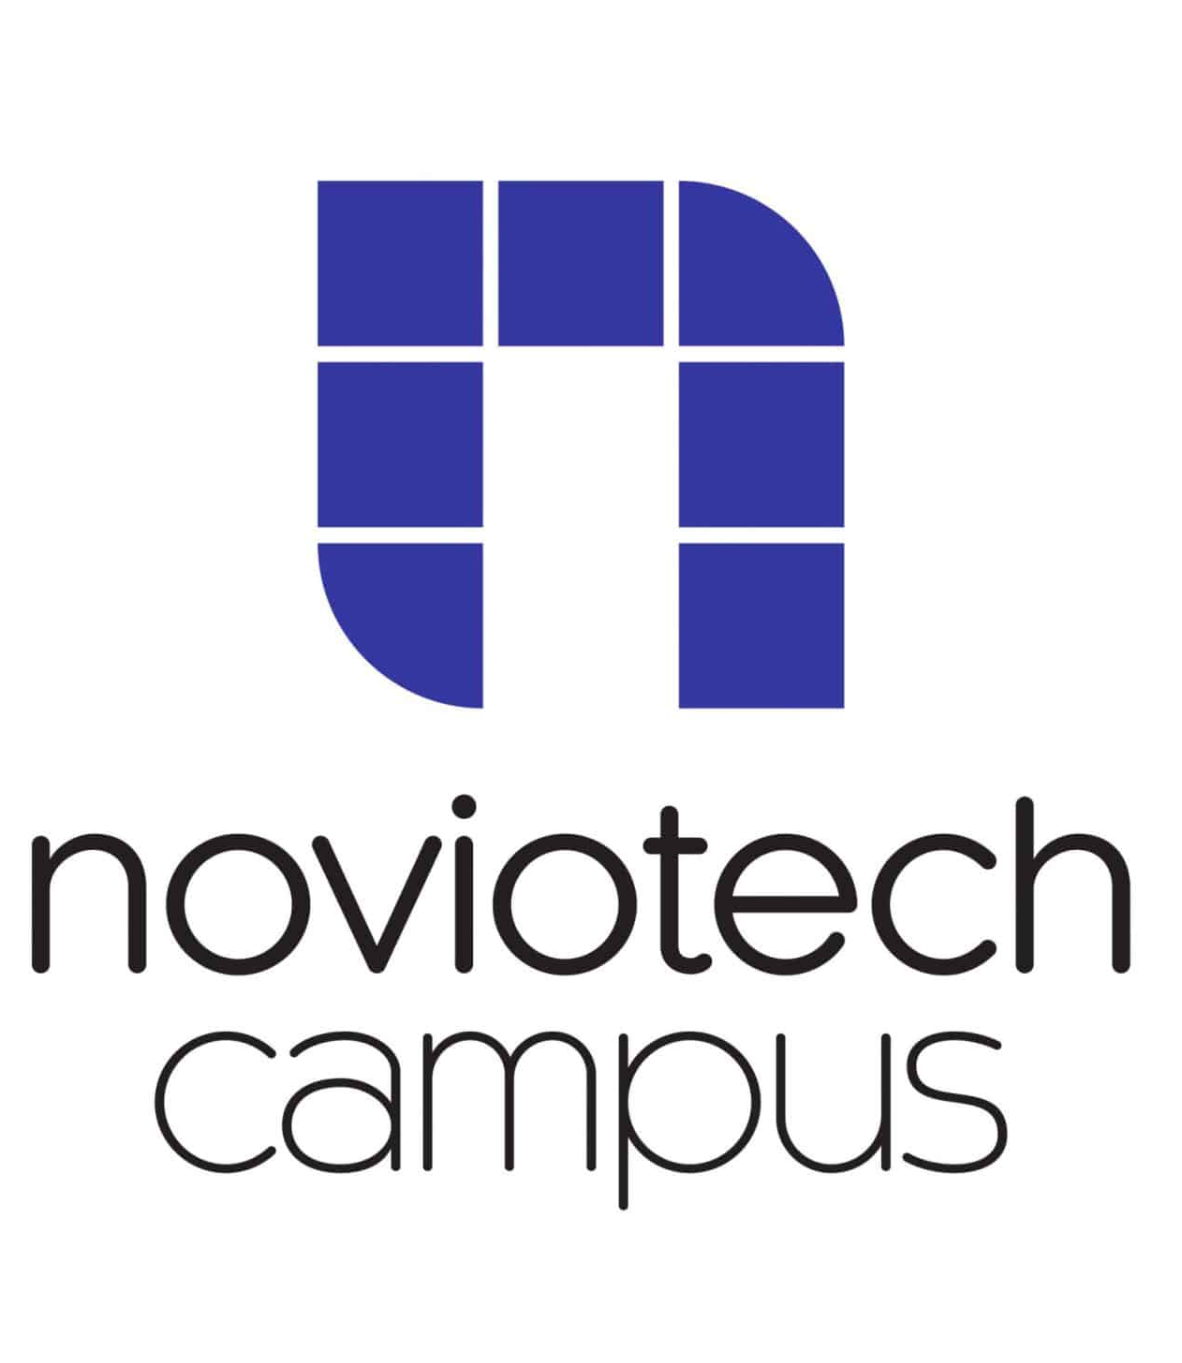
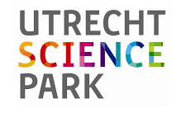

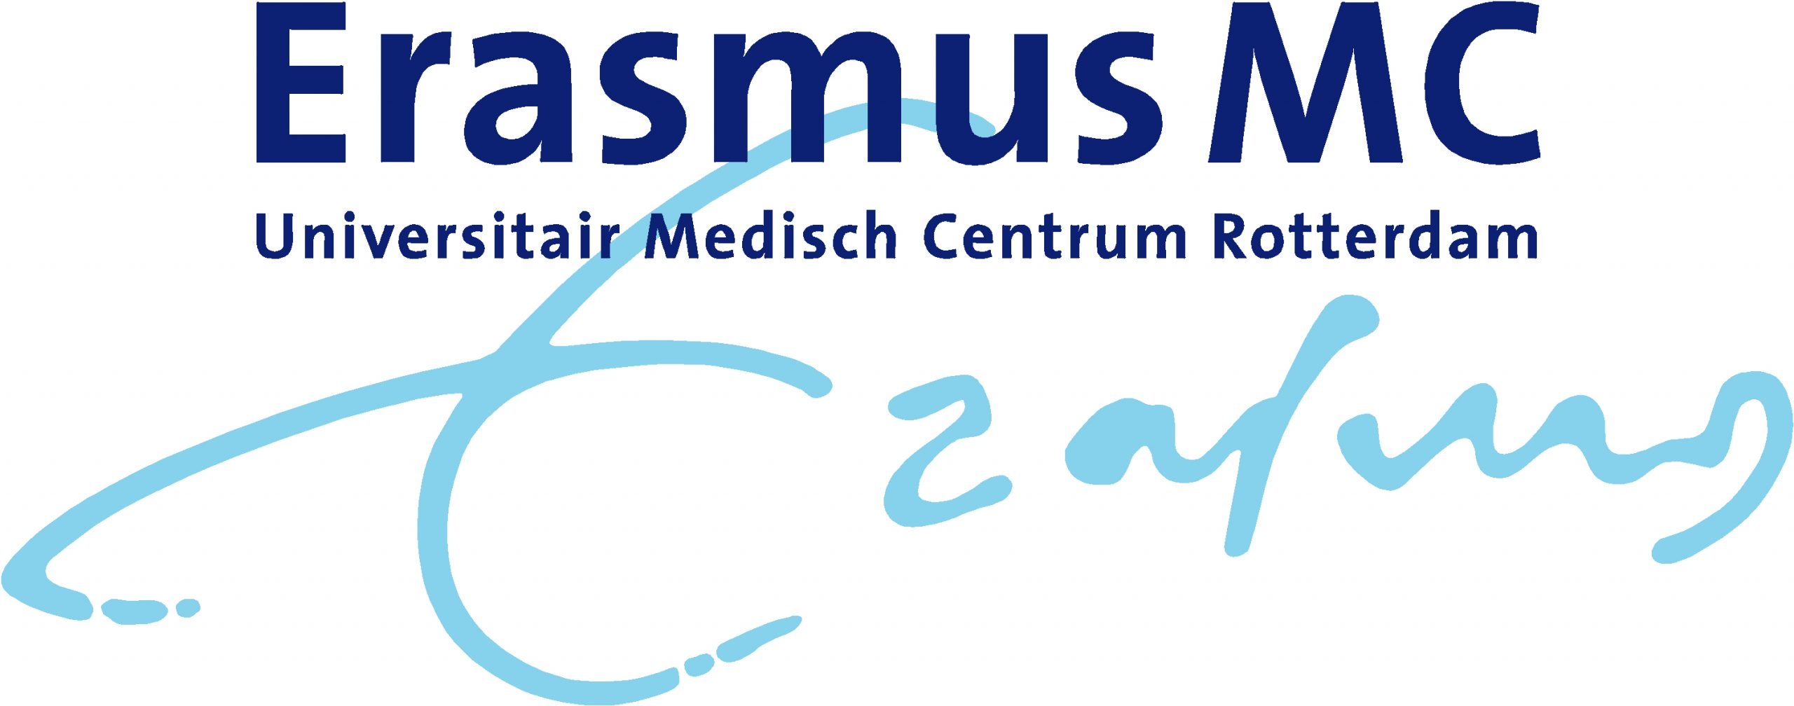

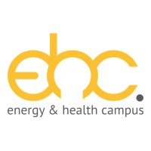





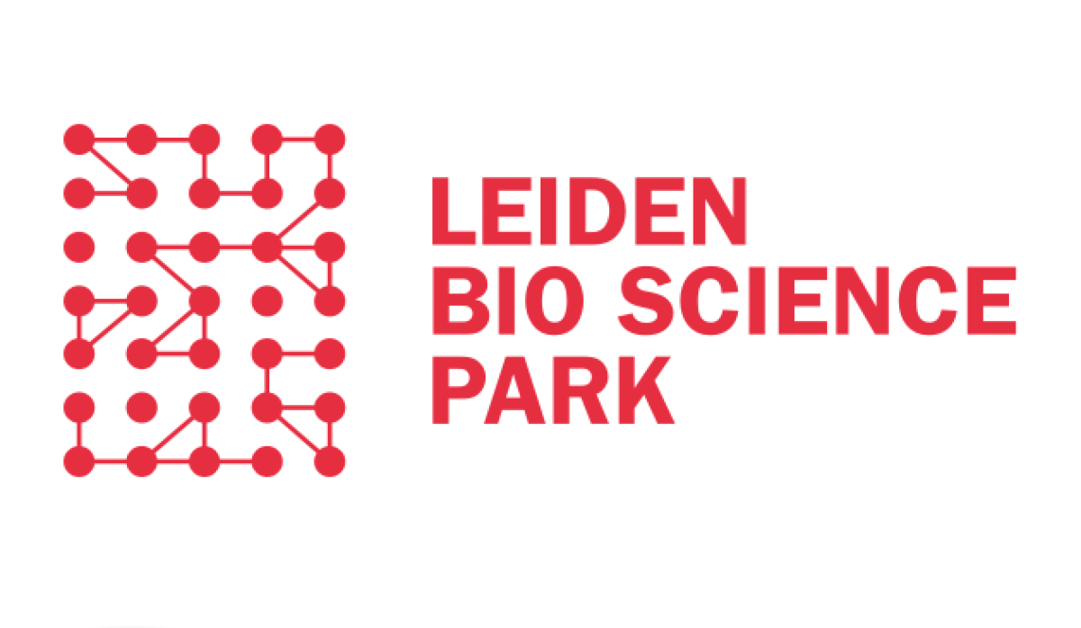

The role of Science parks
Notes:
See page 33 of the bidbook and page 56 - 59

Slide 30
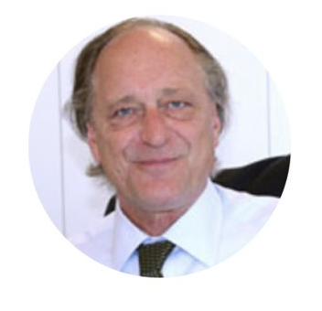
“
Thanks to a large group of start-ups and scale-ups in the field of biotechnology, pharma and medical technology, the Netherlands can continue to play its leading role within the national and international Life Sciences & Health domain, also in the future.
“
Len de Jong
Top Team member, Top Sector Life Sciences & Health (Health~Holland) and CEO Enraf-Nonius
Notes:
Page 33

Slide 31
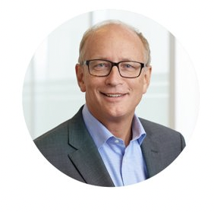

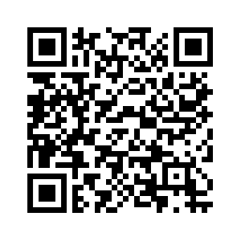
Mission-driven Top Sector and Innovation Policy
“
Working together is part of the Dutch DNA. By collaborating with the best, we can identify innovative solutions that matter. Join us in innovating the future of health, for the benefit of patients and society at large.
Public-Private Partnerships
“
Hans Schikan
Top Team member, Top Sector Life Sciences & Health (Health~Holland)
Notes:
See page 47 – 49 of the bidbook

Slide 32


Public-Private Partnerships
Cardiovascular disease is still one of the biggest health challenges of our time.
The best Dutch scientists, twenty-two leading organizations representing patients, academia, healthcare professionals, industry and government, have joined forces to establish the Dutch CardioVascular Alliance (DCVA).
The ambition of the DCVA is to lower the cardiovascular disease burden by 25% in 2030 by earlier recognition of disease and rapid translation of excellent science into health improvement.
Notes:
There are currently about 40 strategic, thematic, long-term collaborations within large, national consortia
See page 48-49
Full: Cardiovascular disease is still one of the biggest health challenges of our time. Thanks to excellent science, innovation and effective organization of care, we have been able to successfully combat acute cardiovascular events. We have saved many lives. This, combined with aging, changing lifestyles and diabetes, leads to an increase in the number of chronic heart patients: almost 2 million people in 2030 in the Netherlands, which is 33% more than today. Together with the best Dutch scientists, twenty-two leading organizations representing patients, academia, healthcare professionals, industry and government, have joined forces to establish the Dutch CardioVascular Alliance (DCVA). The ambition of the DCVA is to lower the cardiovascular disease burden by 25% in 2030 by earlier recognition of disease and rapid translation of excellent science into health improvement.

Slide 33
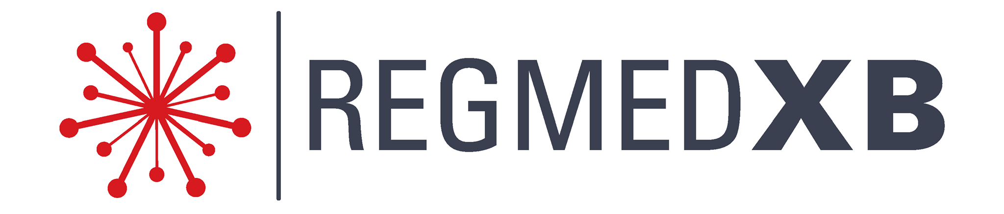
Public-Private Partnerships
RegMed XB is a virtual institute that currently comprises Dutch and Flemish public (universities and governments) and private (health foundations and companies) partners
Aim is to develop regenerative medicine (RM) solutions for patients in order to cure chronic diseases and reduce healthcare expenses.
RegMed XB builds a strong RM ecosystem in which science leads to innovative products and new economic activity.
New 56 million investment in the National Pilot Factory for Regenerative Medicine
Notes:
There are currently about 40 strategic, thematic, long-term collaborations within large, national consortia
See page 48-49
Full: RegMed XB is a virtual institute that currently comprises Dutch and Flemish public (universities and governments) and private (health foundations and companies) partners that aims to develop regenerative medicine (RM) solutions for patients in order to cure chronic diseases and reduce healthcare expenses. RegMed XB builds a strong RM ecosystem in which science leads to innovative products and new economic activity. The closely knitted RM ecosystem facilitates easy interactions between scientists, universities and companies, and with the new 56 million investment in the National Pilot Factory for Regenerative Medicine, RegMed XB partners and the Dutch National Growthfund underscore the importance of solidifying the RM ecosystem further by creating an attractive environment to start new RM initiatives, collaborations and businesses.

Slide 34

Public-Private Partnerships
ABOARD is a large-scale research project carried out by a national, multidisciplinary consortium.
ABOARD envisions a future with individualized prevention encompassing tailored combinations of lifestyle and disease modifying interventions.
At the close of the project, ABOARD has paved the way for a personalized medicine approach for Alzheimer’s Disease (AD).
Patients and care partners are empowered and more actively engaged in the management of their health and disease, and strategies for diagnosis, prediction and prevention of AD have improved.
Notes:
There are currently about 40 strategic, thematic, long-term collaborations within large, national consortia
See page 48-49
Full: ABOARD is a large-scale research project carried out by a national, multidisciplinary consortium. ABOARD envisions a future with individualized prevention encompassing tailored combinations of lifestyle and disease modifying interventions. The mission is realized by a strong multi-sectoral and multidisciplinary consortium, with 32 partners spanning the entire translational value chain. At the close of the project, ABOARD has paved the way for a personalized medicine approach for Alzheimer’s Disease (AD). Patients and care partners are empowered and more actively engaged in the management of their health and disease, and strategies for diagnosis, prediction and prevention of AD have improved.

Slide 35
Notes:
Collaborating parties in the Netherlands

Slide 36
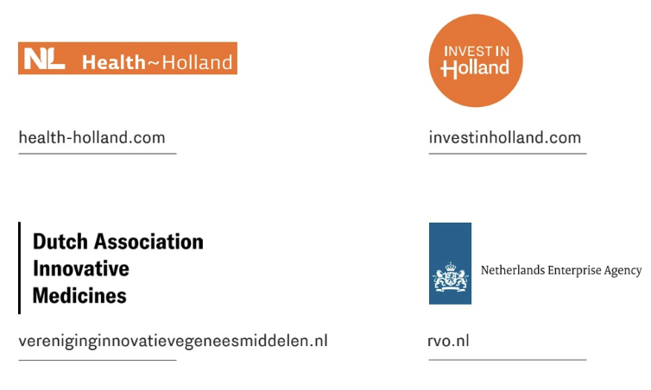
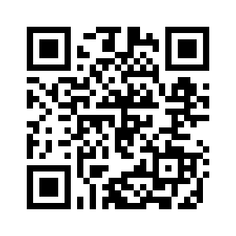
Established by…..
This publication contains a comprehensive overview of the Netherlands’ Life Sciences & Health sector with the goal of attracting foreign LSH companies to the Netherlands. The information contained in the publication has been compiled with great care by Health~Holland (the Top Sector Life Sciences & Health) and its partners and is accurate to the best of its knowledge at the time of publication.
Bidbook

